Slide 1
House Price Project
Team: Data Churning
Chi Zhang
Wei(Evin) Lin

Slide 2
Content
Purpose
Data
Data Cleaning
Feature engineering
Models
Conclusion
Future work

Slide 3
Purpose
We treated it as a learning experience.
Try to understand the general Machine Learning flow, from EDA to model training.
Train the data with as many models as possible to understand the mechanic behind each models

Slide 4
Data
Let’s take a look at the data
Train - 1460 rows, 81 columns
Test - 1459 rows, 80 columns
A total of 79 features, excluding SalePrice and ID
Output variable y = SalePrice
Input variable will be determined after data cleaning and feature engineering

Slide 5
Data Cleaning - Inspection
Evaluating Output Variables y
Distribution graph
Line graph
Skewness
Kurtosis

Slide 6
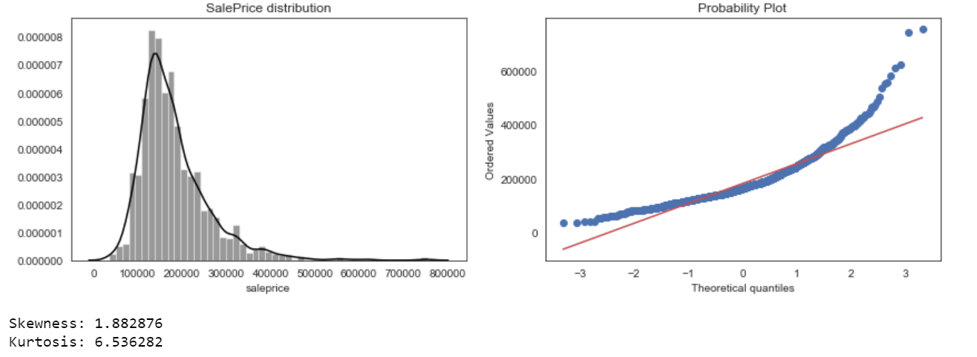
Data Cleaning

Slide 7
Data Cleaning
Evaluating Output Variables y
Positively skewed
Fairly big kurtosis
Non-linear
Most ML models don’t work well with nonlinear data
Log transformation

Slide 8
Data Cleaning
After log transformation
Significantly improved skewness and kurtosis
Fixed nonlinearity

Slide 9
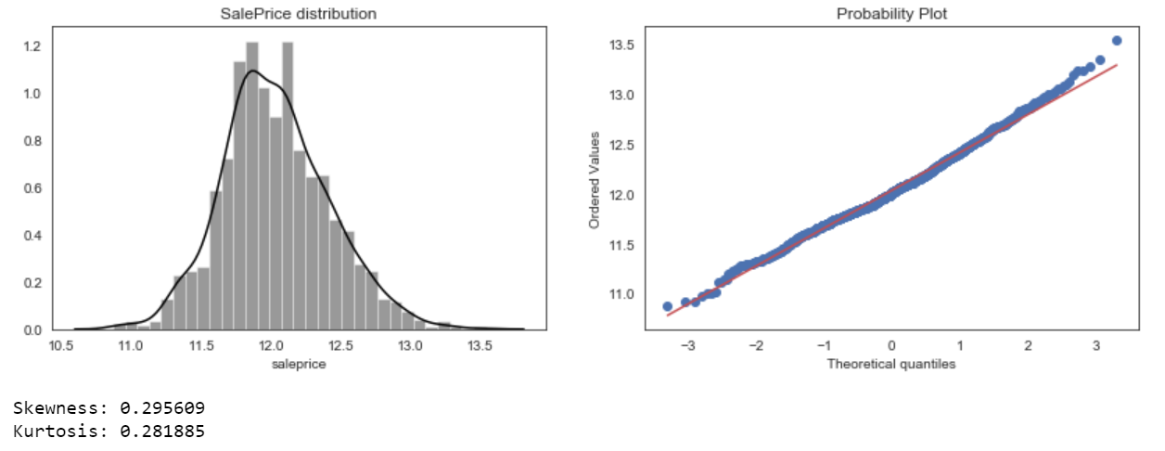
Data Cleaning

Slide 10
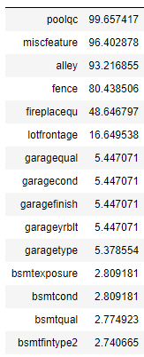
Data Cleaning - Missing values
Data Inspection
34 features have missing values
Notes:
Miscellaneous feature - Elevator, 2nd Garage

Slide 11
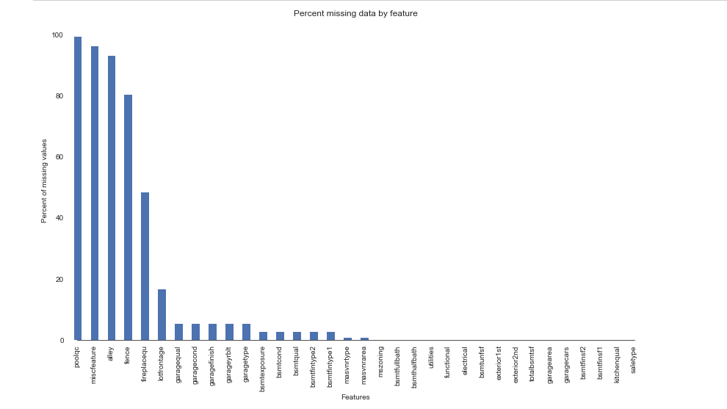
Data Cleaning - Missing values

Slide 12
Cleaning Data - missing
2 types of fill-ins
String fill-in: filling in with “None” and specific string value
Numeric fill-in: filling in with “0” and mode
Example
“Functional” - fill-in with “typ”
“Saletype” - fill-in with mode
For object-type features, fill-in with “None”
For non-object type features, fill-in with 0

Slide 13
Feature Engineering
Creating new features
Total home quality = overall material + overall condition
Total square feet = first floor sqf + second floor sqf + basement sqf
Year built and remodel = year built + year remodel
Total feet = first floor + second floor + basement type 1 + basement type 2
With the 4 new features, we now have a total of 83 features

Slide 14
Feature Engineering
Fix Skewness -- Box-Cox Transformation
Basically transforming non-linear features to somehow linear features
Purpose: for training regression model
Result
Significantly reduced some features’ skewness

Slide 15
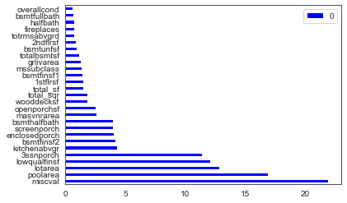
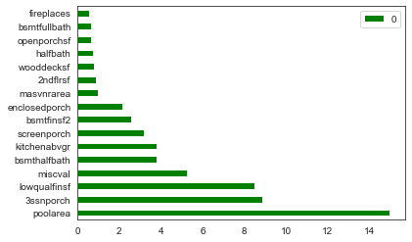
Feature Engineering
Fix Feature Skewness -- Box-Cox Transformation
Skewness > 0.5

Slide 16
Removing outliers
Applying Ridge and ElasticNet models
Using Z-score
According to empirical rule, any z-score greater than 3 or less than -3 is considered to be an outlier
Apply using both model, and remove outliers from both models
Result: successfully removed a total of 34 outliers

Slide 17
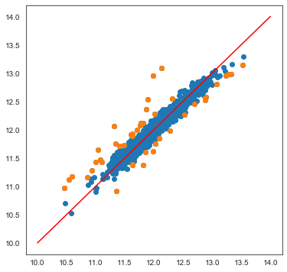
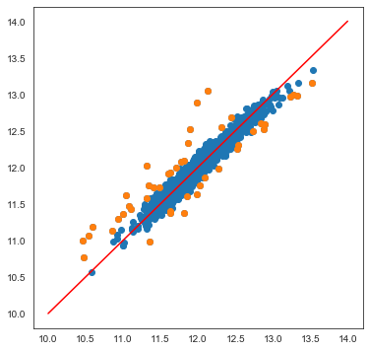
Feature Engineering
Ridge Elastic Net

Slide 18
Data preparation
Filling in missing values
Adjusting skewness - normality
Removing outliers
Now, the data is good for training

Slide 19
Training Flow
K-Fold Cross Validation: 10 folds
3 linear models, 3 tree based models
Stacking 5 models into a stacking model
Fitting a total of 7 models
Using Blending for final score(RMLSE)

Slide 20
Model
Models that we tried:
Ridge
Lasso
Elastic Net
Random Forest
Gradient Boosting
XGBoosting
Stacking
blending ( for final rmsle)

Slide 21
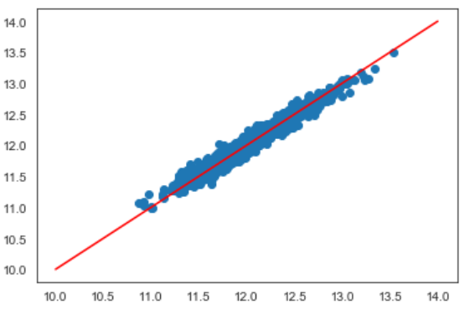
Models
Linear model: Predicted well with an average score(RMSE) of 0.0854667
Ridge : 0.0857
Lasso : 0.0854
Elastic Net : 0.0853
Notes:
Smallest rmse out of all three

Slide 22
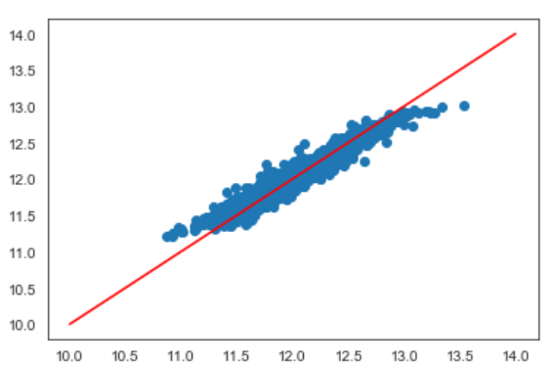
Models
Tree Based Models : An average score(RMSE) 0.1083
Random Forest : 0.1166
Gradient Boosting : 0.0899
XGBoosting : 0.1184

Slide 23
Models
Stacking
Combining all of 5 models(Ridge, Lasso, Elastic Net, Gradient Boost, and Random Forest ) via Meta-Regressor: XGBoosting
Score - 0.0927
Notes:
Ensemble methods are meta-algorithms that combine several machine learning techniques into one predictive model in order to decrease variance (bagging), bias (boosting), or improve predictions (stacking).

Slide 24
Models
Blending : using the following weights (are determined by each model’s score)
Ridge - 0.1
Lasso - 0.1
ElasticNet - 0.1
Gradient Boosting - 0.2
XGboost - 0.05
Random Forest - 0.1
Stacking - 0.35
Blend - 0.057752 (RMSLE)

Slide 25
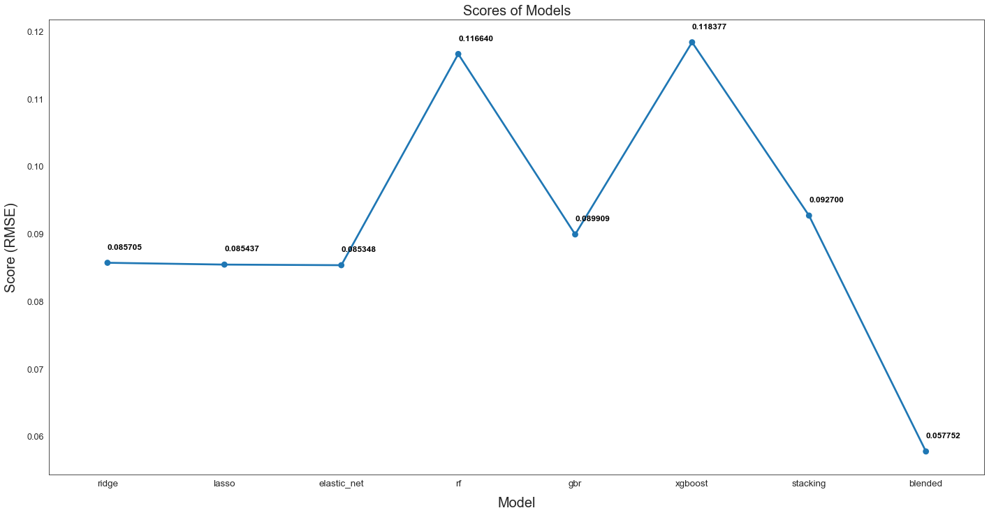
Model Performance

Slide 26
Conclusion
Since output variable is continuous, regression model: Ridge, lasso, and ElasticNet performed well.
Random Forest and Gradient Boosting require more tuning and model improvement.
Stacking and Error metrics helps.
Overall, a fun learning experience.

Slide 27
Future Work
Try to create more new features
Develop more sophisticated models
Apply better model selection to improve result Ex: Tune Hyperparameter, Feature Importance
Notes:
fe - come up more new variables the description,

Slide 28
Q&A

